Slide 1

Texas Tech University
Department of Computer Science
Quantum Computing and Circuit Simulation
Ziqing Guo
Thesis Committee: Dr. Ziwen Pan (Research Advisor)
Professor Zihao Zhan · Dr. Susan Mengel · Dr. Lu Wei
Dean’s representative: Dr. Anne E. V. Gorden
Ziqing Guo
TTU CS Department
1 / 71
Notes:
Good morning, and thank you to the committee for being here: Dr. Pan, Dr. Zhan, Dr. Mengel, Dr. Wei, and Dr. Gorden representing the Graduate School. My dissertation argues that useful quantum computation is delivered by a co-designed stack, not by a quantum processor alone. Over the next fifty minutes I will walk through five layers of that stack and the ten papers behind them.

Slide 2
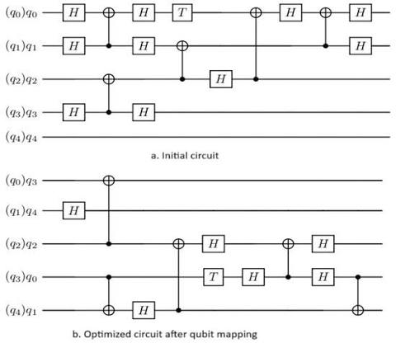


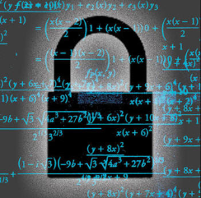
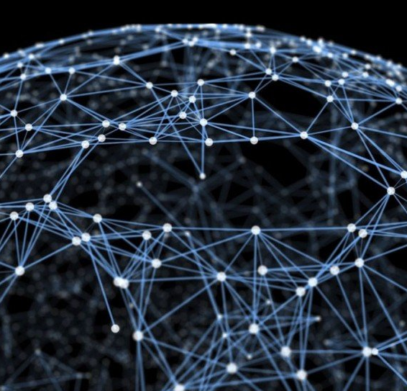
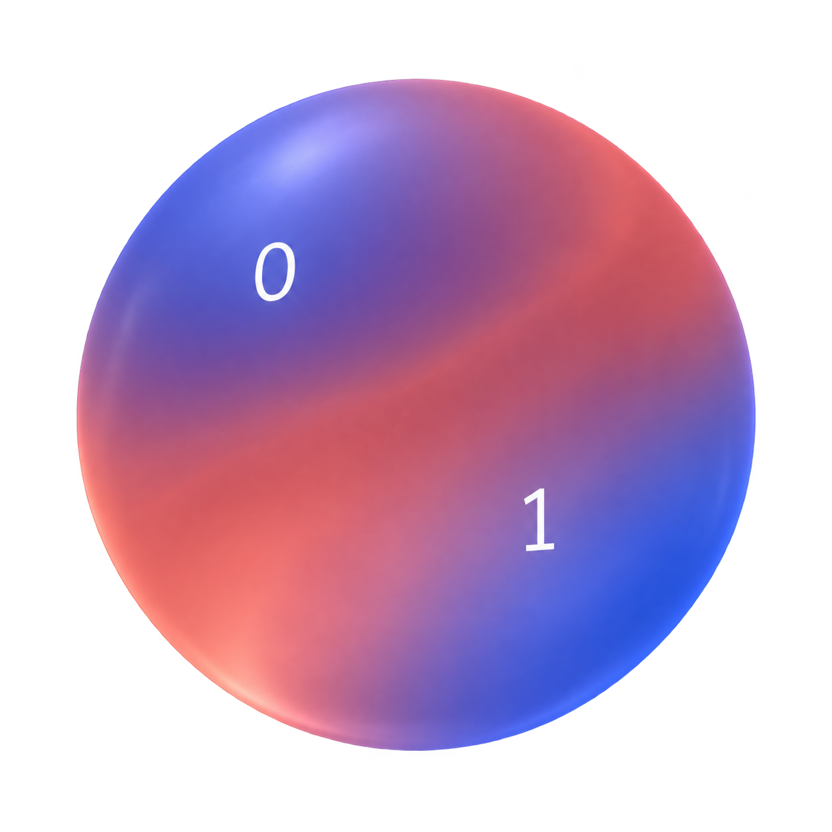
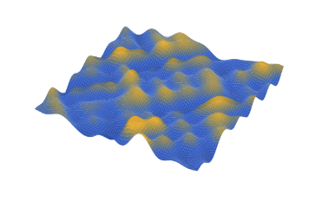
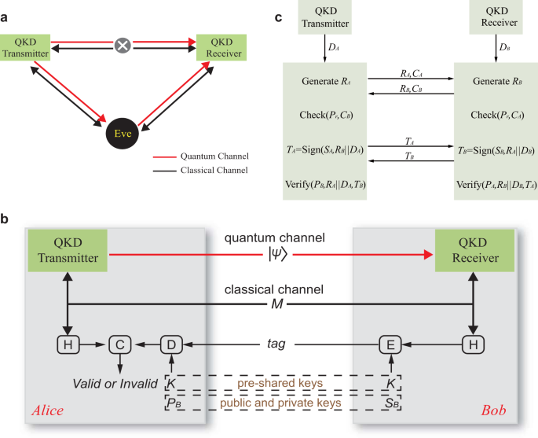

Computing in Quantum
Ziqing Guo
TTU CS Department
2 / 71
Notes:
This is the thesis in one sentence, taken verbatim from the dissertation. The word to underline is co-designed: HPC is not a stopgap until hardware improves, it is a permanent part of how quantum programs are developed, run and trusted. Each of the following sections adds one layer to that stack.

Slide 3
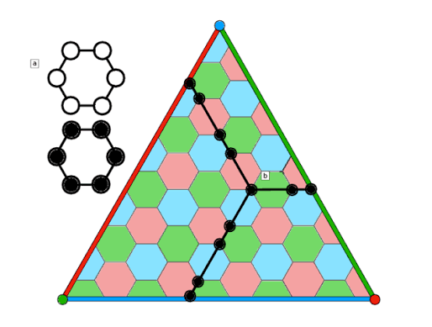
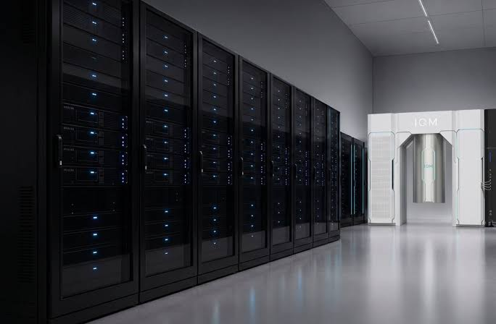
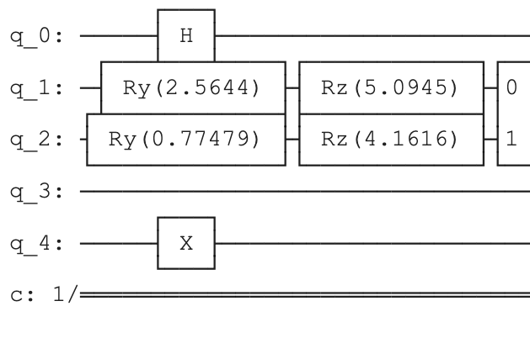
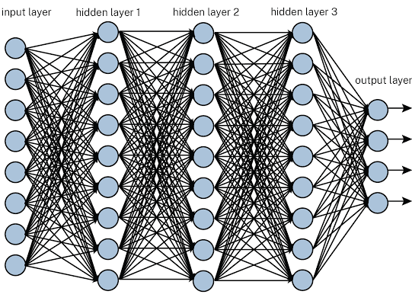
Applications & Research
01 · RQ1 · Scale
02 · RQ2 · QIP
03 · RQ4 · Synthesis
04 · RQ3 · LLM
05 · RQ5 · Trust
Simulation
Algorithms
Optimization
LLMs
QEC
GPU / QPU simulation beyond hardware reach
Structure from problem and device, not black-box search
AI/HPC synthesis within fault-tolerant budgets
Auditable QEC and post-quantum cryptography
AI for quantum
Ziqing Guo
TTU CS Department
3 / 71
Notes:
These five cards are the map for the whole talk. Simulation: GPU-accelerated simulation to develop, verify and calibrate circuits at scales the hardware cannot yet reach. Algorithms: hardware-aware design that replaces black-box variational optimization with structure from the problem and the device. Data encoding: structured, vectorized encodings that make the classical–quantum interface efficient and learnable. Synthesis: AI/HPC-driven synthesis toward fault-tolerant resource budgets. Trust: security-aware error correction and post-quantum cryptography on shared cloud hardware. they will come back as a small rail on every section divider so you always know where we are. Layers one and two are about scale and noise, layer three is the data interface, layer four is synthesis and cost, and layer five is trust. Each layer maps onto exactly one research question.

Slide 4
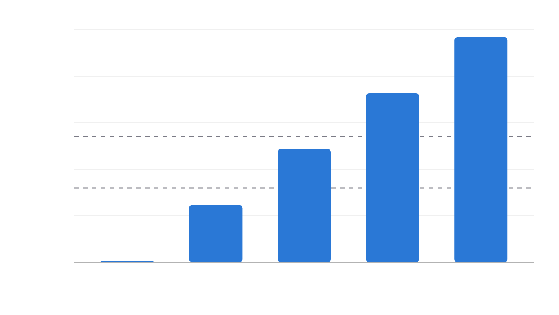
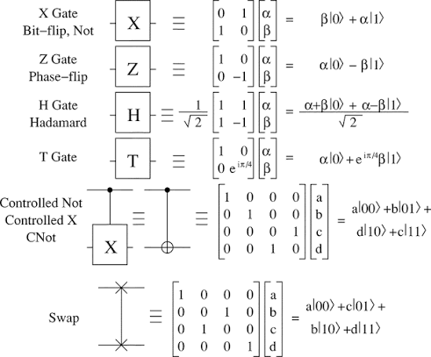
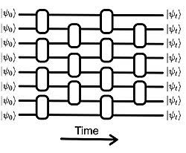
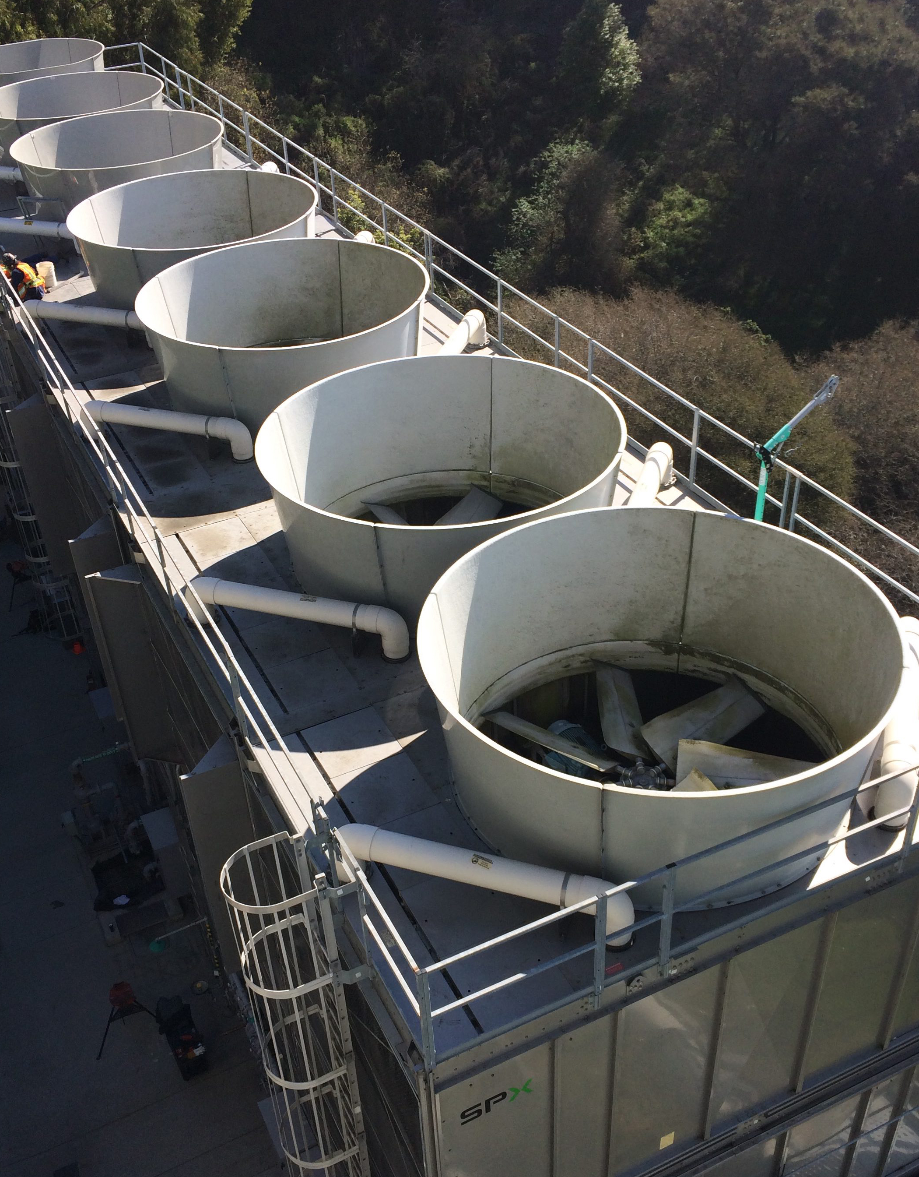
gate-based quantum computing
Background: classical QC simulation
state-vector memory (2ⁿ × 16 B, log scale)
100 TB
70 TB
10 TB
4.4 TB
1 TB
CPU node · 512 GB
275 GB
100 GB
A100 · 40 GB
17 GB
10 GB
1.1 GB
1 GB
26
30
34
38
42
qubits n
Nielsen, Michael A., and Isaac L. Chuang. Quantum computation and quantum information. Vol. 1. Cambridge: Cambridge university press, 2000.
Ziqing Guo
TTU CS Department
4 / 71
Notes:
Exact state-vector simulation is the reference tool for developing and verifying circuits, but its memory doubles per qubit. At 42 qubits the state alone is about seventy terabytes in double precision, far beyond any single node. The question for RQ1 is how far HPC can push this and whether a Qiskit program can use that capability without being rewritten.

Slide 5
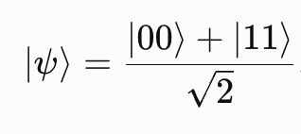

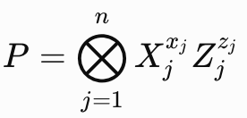



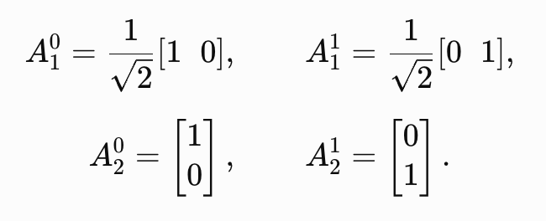
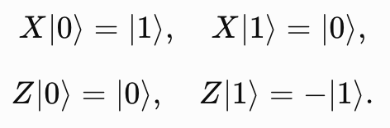
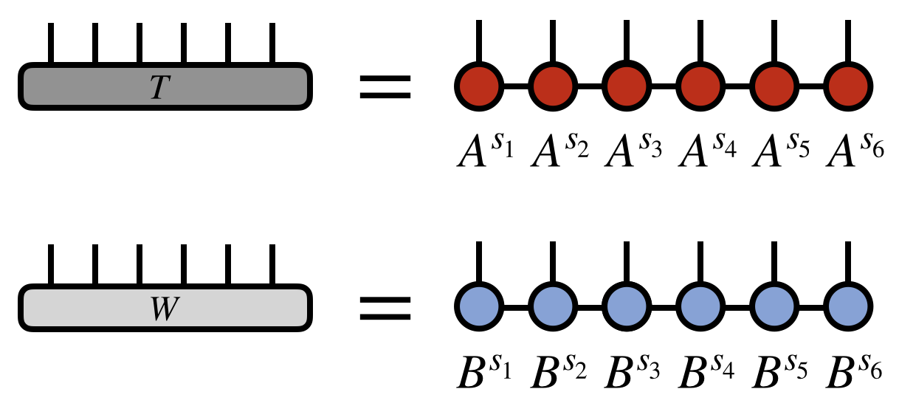
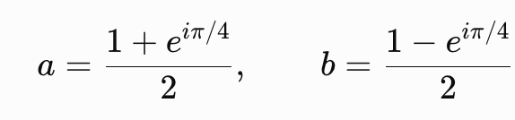
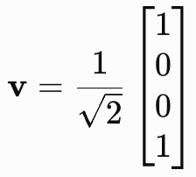
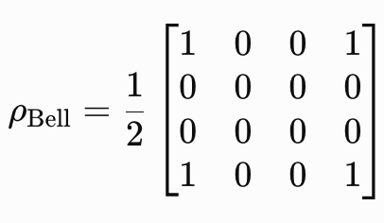

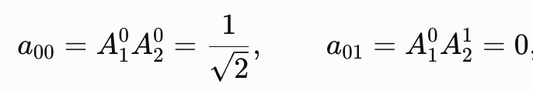
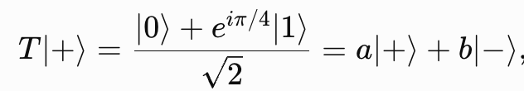
Background
Circuit simulators
Qirsp / qiskit / cudaq
Itensors, qiskit
Stim / tsim
Exact
Approx~
QEC
Statevector / Density Matrices
Tensor Network (MPS)
Stabilizer Pauli Frame Tracking / extended T-gate Stabilizer (quantum error correction)
Ziqing Guo
TTU CS Department
5 / 71
Notes:
The second wall is noise. Even on the best Heron processor we used, the median two-qubit error is about one and a half per mille, so a 20-qubit optimization circuit stops improving after roughly forty CZ gates. Black-box variational loops multiply this cost by hundreds of executions. RQ2 asks how to exploit problem and hardware structure instead.

Slide 6
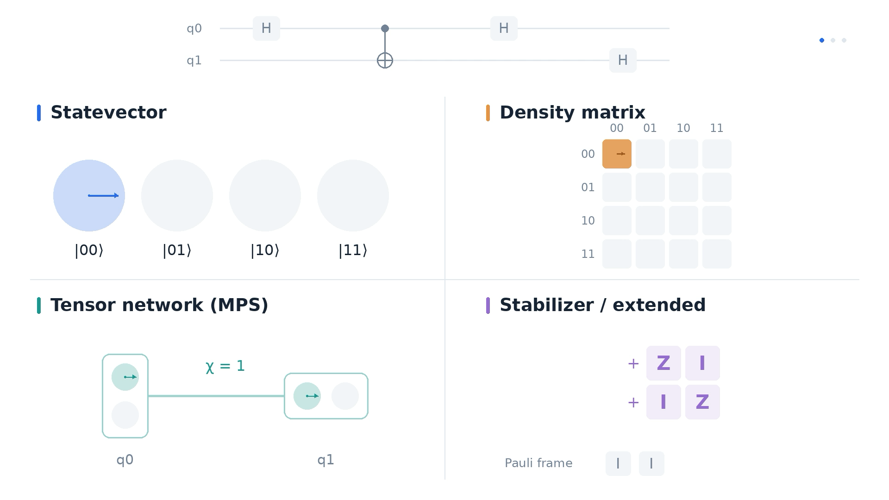
Circuit simulators
Ziqing Guo
TTU CS Department
6 / 71

Slide 7
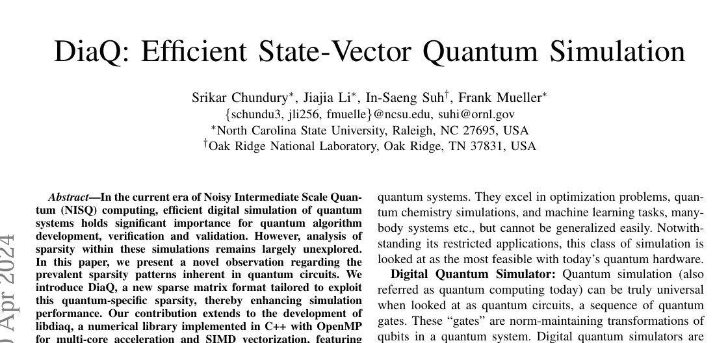
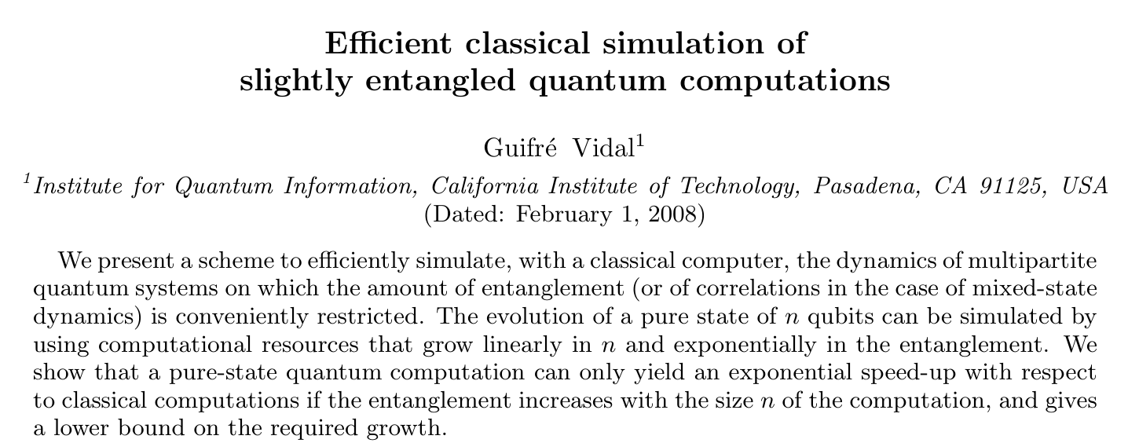
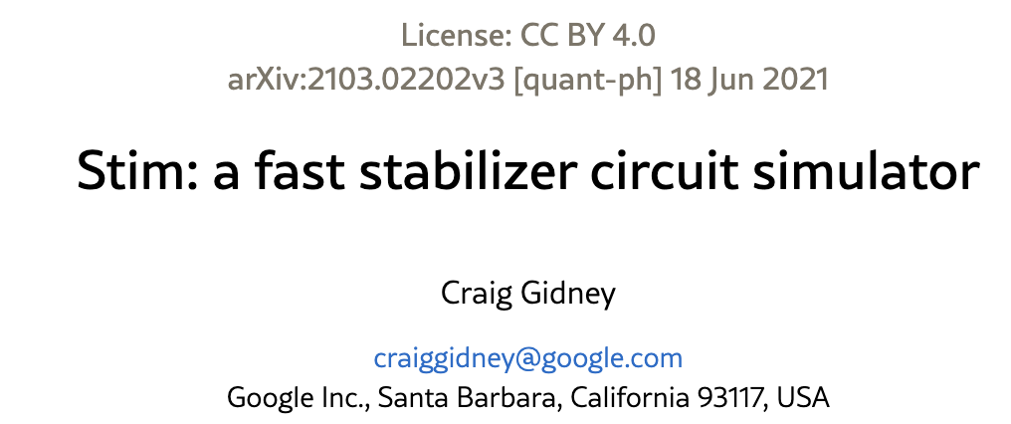
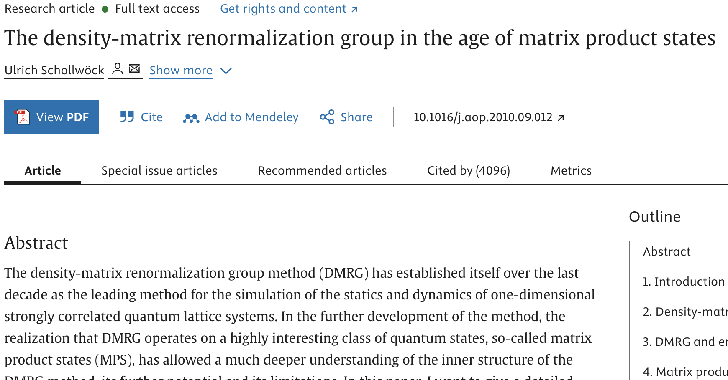
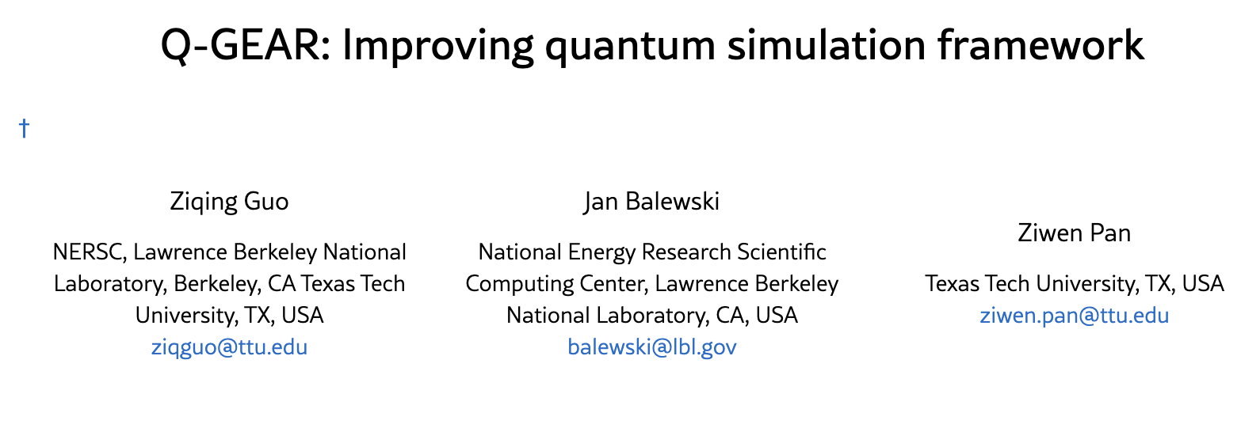
Circuit Simulators Literature
Ziqing Guo
TTU CS Department
7 / 71

Slide 8
Applications & Research
01 · RQ1 · Scale
02 · RQ2 · QIP
03 · RQ4 · Synthesis
04 · RQ3 · LLM
05 · RQ5 · Trust
Simulation
Algorithms
Optimization
LLMs
QEC
GPU / QPU simulation beyond hardware reach
Structure from problem and device, not black-box search
AI/HPC synthesis within fault-tolerant budgets
Auditable QEC and post-quantum cryptography
AI for quantum
Ziqing Guo
TTU CS Department
8 / 71
Notes:
These five cards are the map for the whole talk. Simulation: GPU-accelerated simulation to develop, verify and calibrate circuits at scales the hardware cannot yet reach. Algorithms: hardware-aware design that replaces black-box variational optimization with structure from the problem and the device. Data encoding: structured, vectorized encodings that make the classical–quantum interface efficient and learnable. Synthesis: AI/HPC-driven synthesis toward fault-tolerant resource budgets. Trust: security-aware error correction and post-quantum cryptography on shared cloud hardware. they will come back as a small rail on every section divider so you always know where we are. Layers one and two are about scale and noise, layer three is the data interface, layer four is synthesis and cost, and layer five is trust. Each layer maps onto exactly one research question.

Slide 9
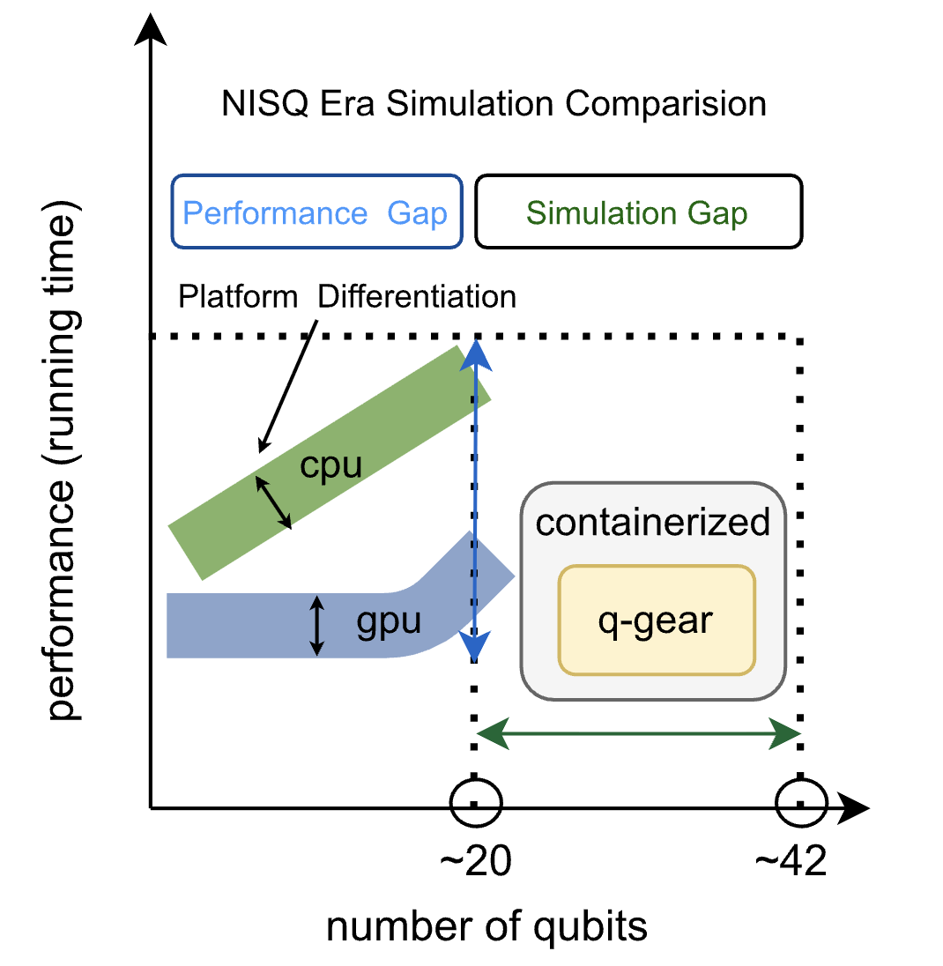
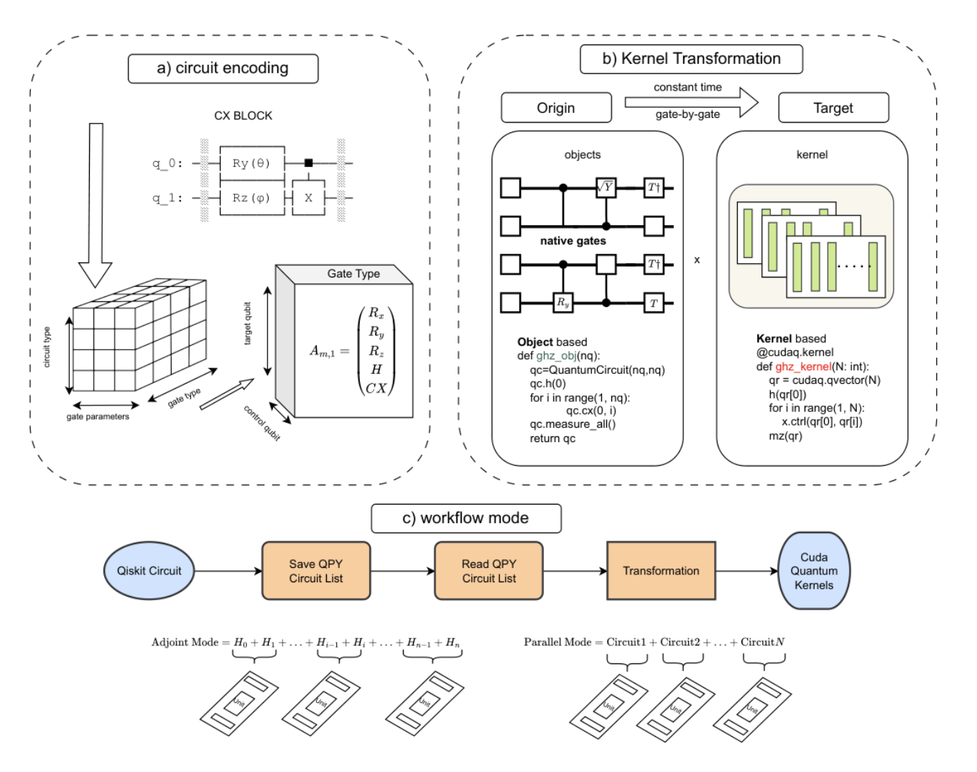
Simulation
Ziqing Guo
TTU CS Department
9 / 71

Slide 10
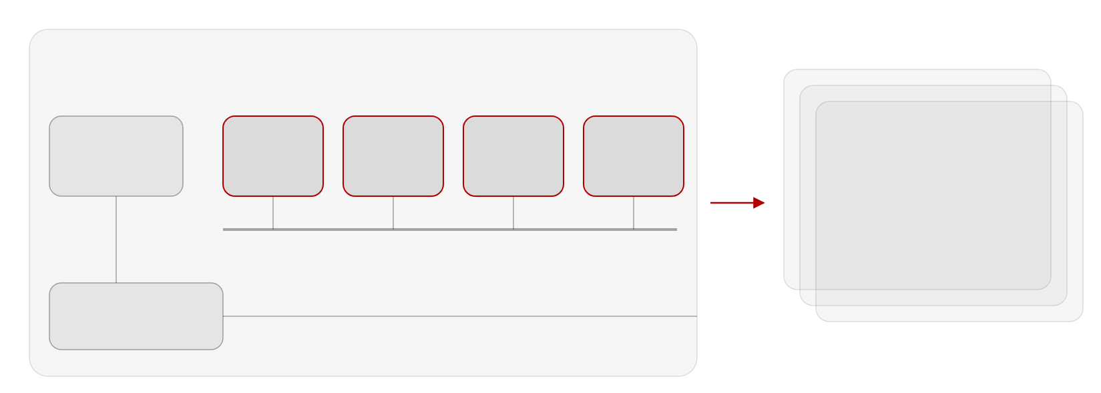

Deployment
Simulation
GPU nodes
1 × AMD EPYC CPU · 4 × NVIDIA A100 (40 GB) · NVLink · Slingshot NIC
CPU
A100 #0
A100 #1
A100 #2
A100 #3
… × 256 nodes
AMD EPYC
40 GB
40 GB
40 GB
40 GB
1,024 A100 GPUs · MPI
42-qubit state vector in
aggregate GPU memory
NVLink · state vector sharded across the four GPUs (CUDA-Q multi-GPU)
≈100% GPU utilization
Slingshot NIC
to other nodes
Ziqing Guo
TTU CS Department
10 / 71
Notes:
Each Perlmutter GPU node has four 40-gigabyte A100s connected by NVLink, and CUDA-Q's multi-GPU backend shards the state vector across them. Beyond one node, MPI over the Slingshot interconnect lets us aggregate memory across nodes: 256 nodes give 1,024 GPUs, which is where the 42-qubit runs happened at close to full GPU utilization.

Slide 11
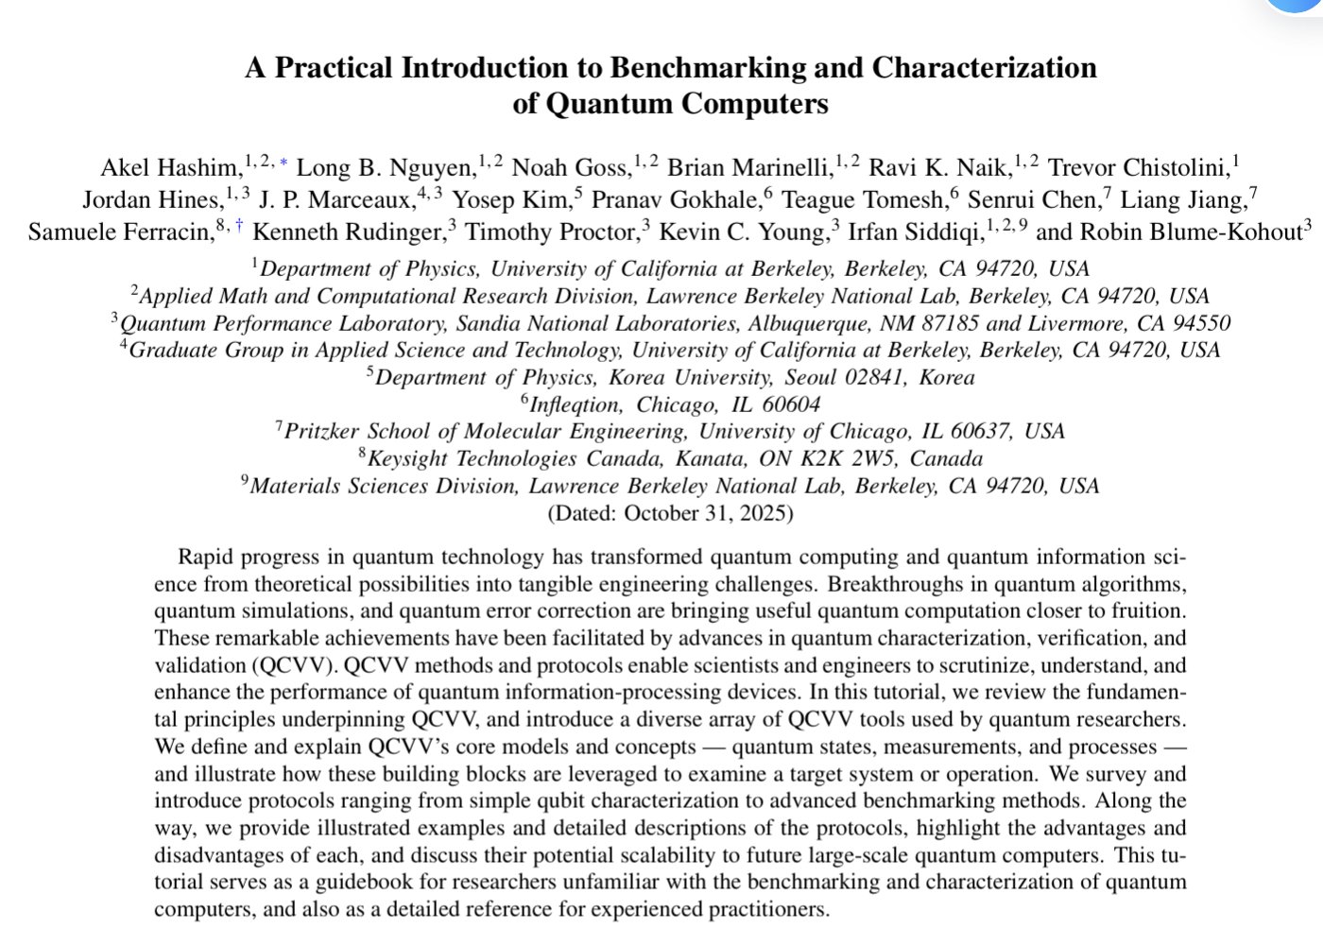
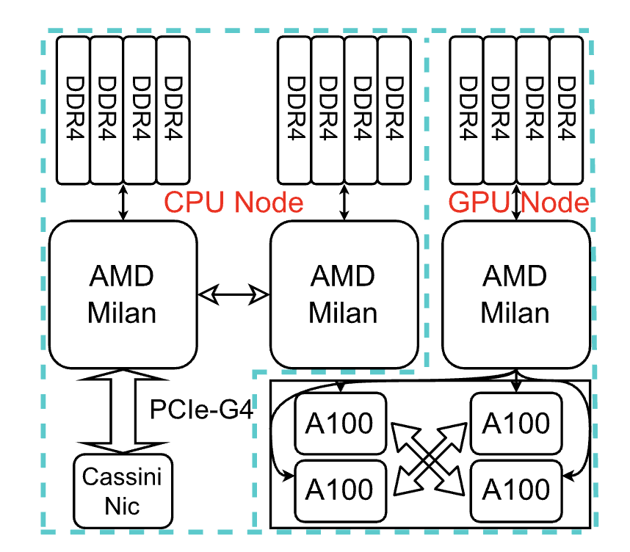
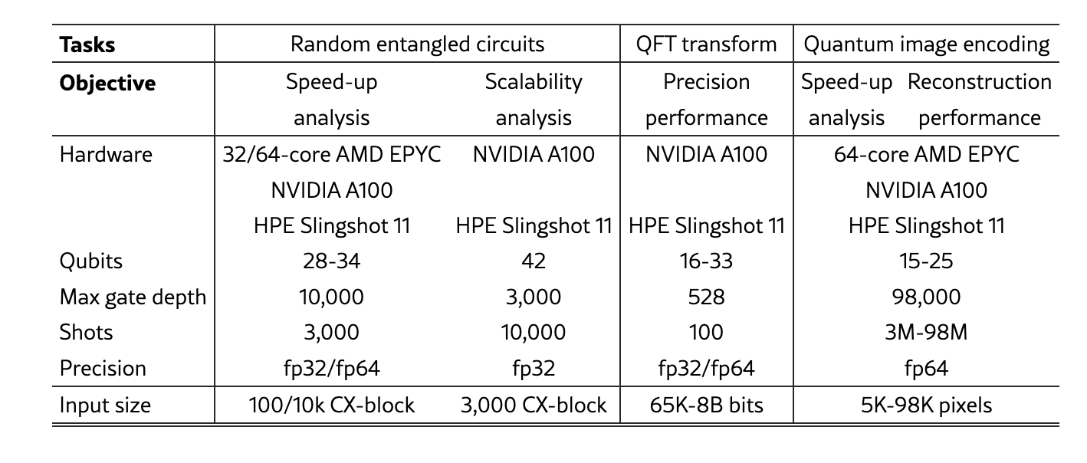
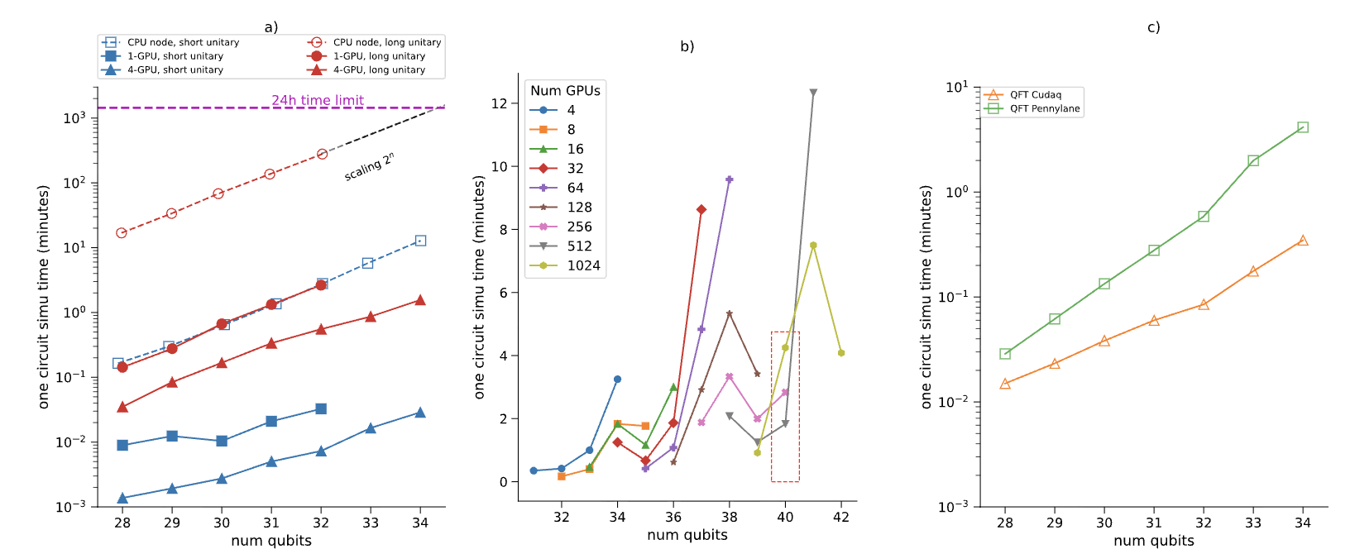
Simulation & Results
GPU -> processes -> warps -> threads
Ziqing Guo
TTU CS Department
11 / 71

Slide 12
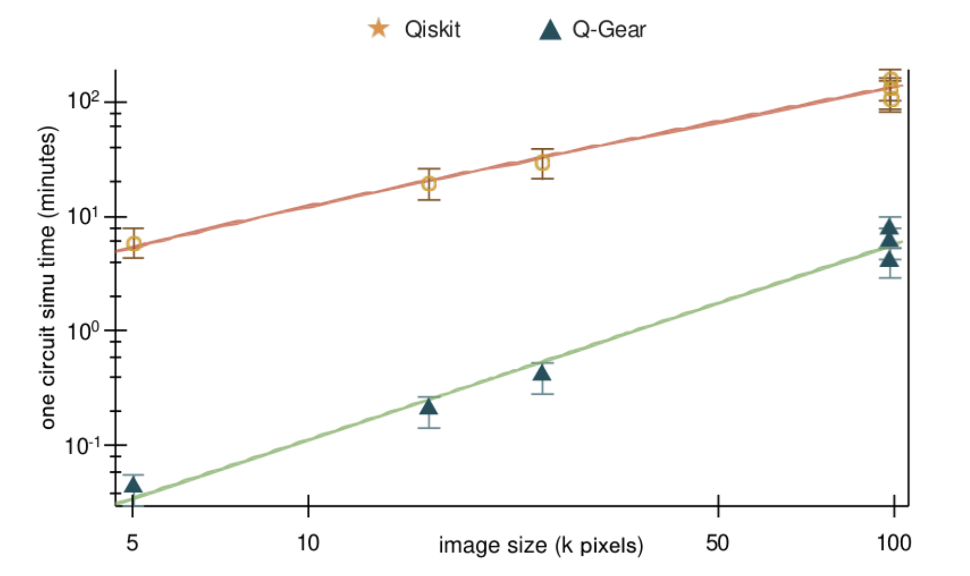
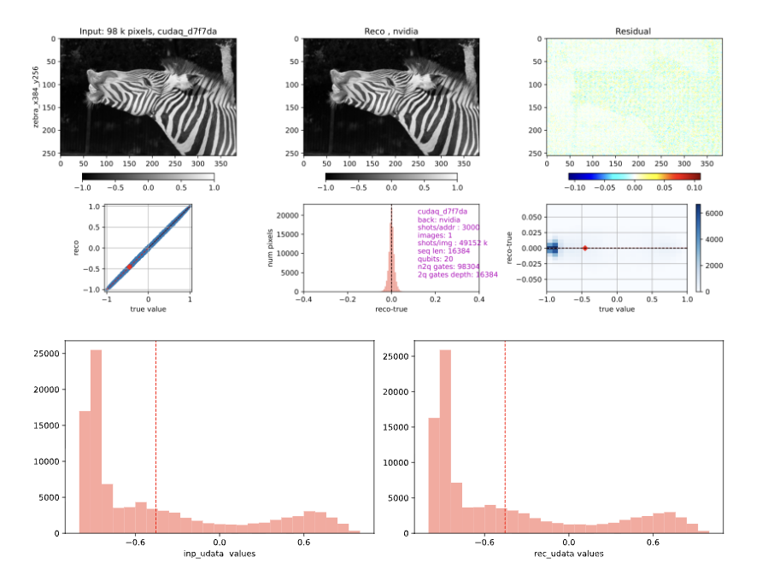
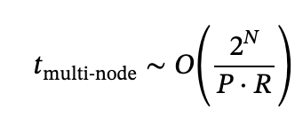

Simulation
Nvidia collaboration
redesign CudaQ framework
Mathematical
Tensors store gate-by-gate
kernel transformation
Main take away
Ziqing Guo
TTU CS Department
12 / 71

Slide 13
Applications & Research
01 · RQ1 · Scale
02 · RQ2 · QIP
03 · RQ4 · Synthesis
04 · RQ3 · LLM
05 · RQ5 · Trust
Simulation
Algorithms
Optimization
LLMs
QEC
GPU / QPU simulation beyond hardware reach
Structure from problem and device, not black-box search
AI/HPC synthesis within fault-tolerant budgets
Auditable QEC and post-quantum cryptography
AI for quantum
Ziqing Guo
TTU CS Department
13 / 71
Notes:
These five cards are the map for the whole talk. Simulation: GPU-accelerated simulation to develop, verify and calibrate circuits at scales the hardware cannot yet reach. Algorithms: hardware-aware design that replaces black-box variational optimization with structure from the problem and the device. Data encoding: structured, vectorized encodings that make the classical–quantum interface efficient and learnable. Synthesis: AI/HPC-driven synthesis toward fault-tolerant resource budgets. Trust: security-aware error correction and post-quantum cryptography on shared cloud hardware. they will come back as a small rail on every section divider so you always know where we are. Layers one and two are about scale and noise, layer three is the data interface, layer four is synthesis and cost, and layer five is trust. Each layer maps onto exactly one research question.

Slide 14

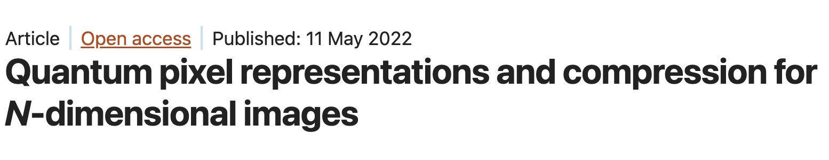
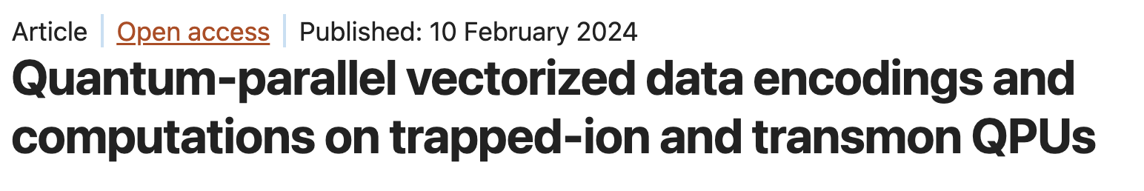
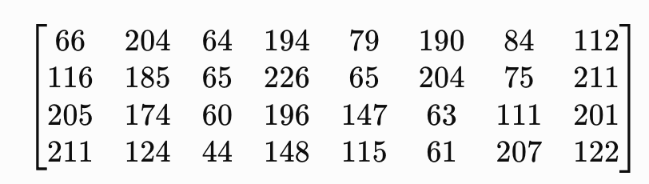
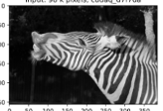
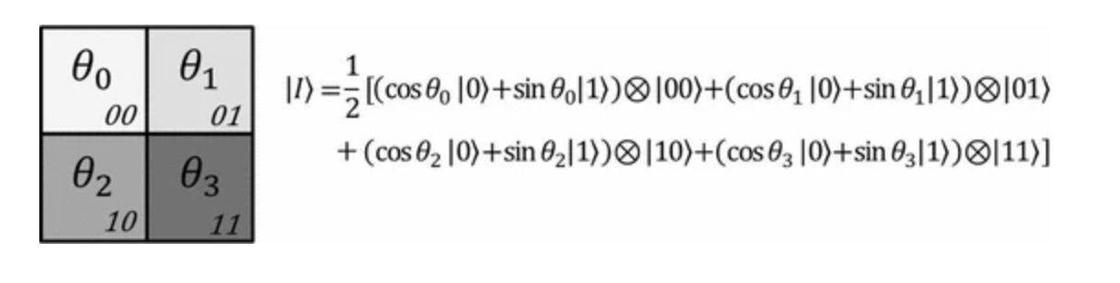
Algorithms
ascii
Ziqing Guo
TTU CS Department
14 / 71

Slide 15
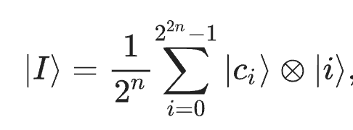
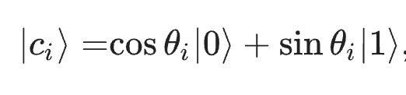
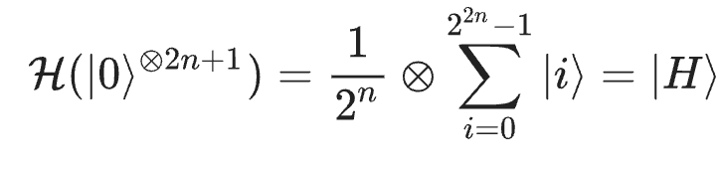
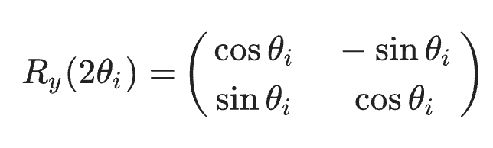
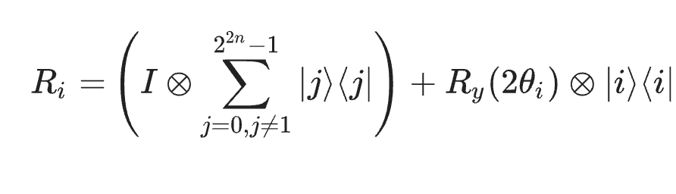



Algorithms
Ziqing Guo
TTU CS Department
15 / 71

Slide 16






Algorithms
Decoding
Probability density function (PDF)
Ziqing Guo
TTU CS Department
16 / 71

Slide 17







Algorithms
Quantum computing is linear how do we enable universal quantum
capability for classical computation?
X+Y?
X*Y
Quantum arithmetic
Arccos(x)
Ziqing Guo
TTU CS Department
17 / 71

Slide 18













w*arccos(x1))* (1-w) * arccos(x2)
Algorithms
arccos(x1))*arccos(x2)
Z
Ziqing Guo
TTU CS Department
18 / 71

Slide 19

Algorithms
Ziqing Guo
TTU CS Department
19 / 71

Slide 20




Algorithms
Why Ry rotation?
Ziqing Guo
TTU CS Department
20 / 71

Slide 21


Algorithms
Putting it all together for Polynomial nonlinear function
Ziqing Guo
TTU CS Department
21 / 71

Slide 22


NISQ RESULTS
Algorithms
1.46×10⁻³
≈41–43
median CZ error, IBM Heron-3 (best device used)
CZ gates before 20-qubit circuits degrade on Heron
Ziqing Guo
TTU CS Department
22 / 71
Notes:
The second wall is noise. Even on the best Heron processor we used, the median two-qubit error is about one and a half per mille, so a 20-qubit optimization circuit stops improving after roughly forty CZ gates. Black-box variational loops multiply this cost by hundreds of executions. RQ2 asks how to exploit problem and hardware structure instead.

Slide 23



CAN WE ACHIEVE QUANTUM INFORMATION ADAVANTAGE
Algorithms
LLM has linear operation
Quick review for modern LLM architecture
Ziqing Guo
TTU CS Department
23 / 71

Slide 24


Algorithms
https://bbycroft.net/llm
Ziqing Guo
TTU CS Department
24 / 71

Slide 25





Algorithms
Ziqing Guo
TTU CS Department
25 / 71

Slide 26

Algorithms
Ziqing Guo
TTU CS Department
26 / 71

Slide 27




Algorithms
FLOPS
CLOPS
Vectorized attention dot product
Ziqing Guo
TTU CS Department
27 / 71

Slide 28



Result
Algorithms
28 / 71

Slide 29


Algorithms
Reloadable nonlinear function solver with
quantum circuit simulation
Circuit Cutting and Knitting
Ziqing Guo
TTU CS Department
29 / 71

Slide 30






Algorithms
Two options:
Postprocess with MPS
MPS cutting
local operations and classical communication (LOCC)
Ziqing Guo
TTU CS Department
30 / 71

Slide 31




NISQ RESULTS
Algorithms
Ziqing Guo
TTU CS Department
31 / 71

Slide 32





Algorithms
We collaborate with quantum lab (UMD) for getting the correct native Gpi gate / MZ-based CZ gate routing
Because of the
Postprocessing requires
Correct bitstrings order
Ziqing Guo
TTU CS Department
32 / 71

Slide 33
Applications & Research
01 · RQ1 · Scale
02 · RQ2 · QIP
03 · RQ4 · Synthesis
04 · RQ3 · LLM
05 · RQ5 · Trust
Simulation
Algorithms
Optimization
LLMs
QEC
GPU / QPU simulation beyond hardware reach
Structure from problem and device, not black-box search
AI/HPC synthesis within fault-tolerant budgets
Auditable QEC and post-quantum cryptography
AI for quantum
Ziqing Guo
TTU CS Department
33 / 71
Notes:
These five cards are the map for the whole talk. Simulation: GPU-accelerated simulation to develop, verify and calibrate circuits at scales the hardware cannot yet reach. Algorithms: hardware-aware design that replaces black-box variational optimization with structure from the problem and the device. Data encoding: structured, vectorized encodings that make the classical–quantum interface efficient and learnable. Synthesis: AI/HPC-driven synthesis toward fault-tolerant resource budgets. Trust: security-aware error correction and post-quantum cryptography on shared cloud hardware. they will come back as a small rail on every section divider so you always know where we are. Layers one and two are about scale and noise, layer three is the data interface, layer four is synthesis and cost, and layer five is trust. Each layer maps onto exactly one research question.

Slide 34





Optimization
Ziqing Guo
TTU CS Department
34 / 71

Slide 35

Optimization
D here is the graph degrees
n is total number of bits (n = D+1)
35 / 71

Slide 36







Optimization
2019
Ziqing Guo
TTU CS Department
36 / 71

Slide 37


Optimization
37 / 71

Slide 38



Optimization
Ziqing Guo
TTU CS Department
38 / 71

Slide 39


Optimization
Can we map the problem directly into quantum circuit based on the clause (constraint)?
Ziqing Guo
TTU CS Department
39 / 71

Slide 40


Optimization
Ziqing Guo
TTU CS Department
40 / 71

Slide 41



Optimization
Ziqing Guo
TTU CS Department
41 / 71

Slide 42



Optimization
Ziqing Guo
TTU CS Department
42 / 71

Slide 43





Optimization
Ziqing Guo
TTU CS Department
43 / 71

Slide 44


Optimization
Ziqing Guo
TTU CS Department
44 / 71

Slide 45
Applications & Research
01 · RQ1 · Scale
02 · RQ2 · QIP
03 · RQ4 · Synthesis
04 · RQ3 · LLM
05 · RQ5 · Trust
Simulation
Algorithms
Optimization
LLMs
QEC
GPU / QPU simulation beyond hardware reach
Structure from problem and device, not black-box search
AI/HPC synthesis within fault-tolerant budgets
Auditable QEC and post-quantum cryptography
AI for quantum
Ziqing Guo
TTU CS Department
45 / 71
Notes:
These five cards are the map for the whole talk. Simulation: GPU-accelerated simulation to develop, verify and calibrate circuits at scales the hardware cannot yet reach. Algorithms: hardware-aware design that replaces black-box variational optimization with structure from the problem and the device. Data encoding: structured, vectorized encodings that make the classical–quantum interface efficient and learnable. Synthesis: AI/HPC-driven synthesis toward fault-tolerant resource budgets. Trust: security-aware error correction and post-quantum cryptography on shared cloud hardware. they will come back as a small rail on every section divider so you always know where we are. Layers one and two are about scale and noise, layer three is the data interface, layer four is synthesis and cost, and layer five is trust. Each layer maps onto exactly one research question.

Slide 46

LLMs
Ziqing Guo
TTU CS Department
46 / 71

Slide 47

LLMs
What are the frontier AI models are doing?
Not proprietary models but what can we learn
From open-source models
Ziqing Guo
TTU CS Department
47 / 71

Slide 48




Low level computation efficiency
LLMs
how can a model remember earlier tokens without repeatedly searching an ever-growing history
Delta Net
Ziqing Guo
TTU CS Department
48 / 71

Slide 49



LLMs
49 / 71

Slide 50

High Level Harness engineering
LLMs
Ziqing Guo
TTU CS Department
50 / 71

Slide 51



LLMs
AI4Q Ai for quantum
A good way to simulate quantum circuit is to make it explainable
Ziqing Guo
TTU CS Department
51 / 71

Slide 52



LLMs
reinforcement learning with verifiable rewards (RLVR)
Clifford, T-count, hardware, fidelity, efficiency
52 / 71

Slide 53
Applications & Research
01 · RQ1 · Scale
02 · RQ2 · QIP
03 · RQ4 · Synthesis
04 · RQ3 · LLM
05 · RQ5 · Trust
Simulation
Algorithms
Optimization
LLMs
QEC
GPU / QPU simulation beyond hardware reach
Structure from problem and device, not black-box search
AI/HPC synthesis within fault-tolerant budgets
Auditable QEC and post-quantum cryptography
AI for quantum
Ziqing Guo
TTU CS Department
53 / 71
Notes:
These five cards are the map for the whole talk. Simulation: GPU-accelerated simulation to develop, verify and calibrate circuits at scales the hardware cannot yet reach. Algorithms: hardware-aware design that replaces black-box variational optimization with structure from the problem and the device. Data encoding: structured, vectorized encodings that make the classical–quantum interface efficient and learnable. Synthesis: AI/HPC-driven synthesis toward fault-tolerant resource budgets. Trust: security-aware error correction and post-quantum cryptography on shared cloud hardware. they will come back as a small rail on every section divider so you always know where we are. Layers one and two are about scale and noise, layer three is the data interface, layer four is synthesis and cost, and layer five is trust. Each layer maps onto exactly one research question.

Slide 54




QEC
QEC experiments in real-time for up to 1 million rounds.
Ziqing Guo
TTU CS Department
54 / 71

Slide 55

QEC
Ziqing Guo
TTU CS Department
55 / 71

Slide 56



QEC
Why quantum error correction (QEC) is necessary
Long computations require reliability beyond the fidelity of any single physical operation.
QEC lets a computation continue through faults instead of requiring a fault-free run.
https://www.nature.com/articles/s41586-025-09848-5/figures/1
Independent-fault model: P(≥1 fault) = 1 − (1 − p2)^N; p2 = 4 × 10^-4.
Visual reference: Nature 656, 47–53 (2026), Extended Data Fig. 1.
Ziqing Guo
TTU CS Department
56 / 71
Notes:
A good gate is not enough
At the two-qubit error rate used in this study, independent faults imply a 98.2% chance of at least one two-qubit gate fault in a 10,000-gate workload: 1 - (1 - 4e-4)^10000. This is an illustrative scaling model, not measured application performance. The management point is that useful circuits cannot depend on every physical operation succeeding; QEC lets the computation continue through faults. The compact graph is an original design informed by the direct-axis, direct-label style of Extended Data Figure 1 in 'An entangling gate for dual-rail erasure qubits,' Nature 656, 47-53 (2026), https://www.nature.com/articles/s41586-026-10822-y.

Slide 57





How about making this the 3rd slide, title: Fault-tolerant quantum computations?
QEC
Fault-tolerant quantum computations
real time QEC ?
FPGA/ASIC
Ziqing Guo
TTU CS Department
57 / 71
Notes:
The distance series spans 17 to 127 data qubits per logical block. Distance d corrects up to t=(d-1)/2 errors under the code model. We use m=120 and 240 because both have many divisors. If the circuit is split into q=R+1 equal segments, q divides m, so every segment contains exactly m/q random Cliffords and the R QEC rounds are evenly spaced.

Slide 58







QEC
Encoder-> Stabilizer -> Decoder
Example: 4.8.8 [[7, 1, 3]] color code (steane)
Readout bit strings
Raw decoder
distance | 5 | 7 | 9 | 11 | 13 | 15
data qubits | 17 | 31 | 49 | 71 | 97 | 127
num of corr | 2 | 3 | 4 | 5 | 6 | 7
Ziqing Guo
TTU CS Department
58 / 71
Notes:
The distance series spans 17 to 127 data qubits per logical block. Distance d corrects up to t=(d-1)/2 errors under the code model. We use m=120 and 240 because both have many divisors. If the circuit is split into q=R+1 equal segments, q divides m, so every segment contains exactly m/q random Cliffords and the R QEC rounds are evenly spaced.

Slide 59


QEC
Randomized Benchmarking (RB) estimates fidelity
A random Clifford group followed by its exact inverse has a known ideal answer.
https://arxiv.org/pdf/2408.12064
|00>_L
logical error rate (LER)
= 1 − F_L
err: |01>L, |10>L, |11>L
WHY 100 RANDOM RB SEQUENCES?
WHY 1,000 SHOTS PER SEQUENCE?
100 RB sequences × 1,000 shots
= 100,000 shots per RB
One-qubit Clifford group: 24 combinations
Two-qubit : 11,520 combinations
DRBG
They sample variation across random circuits. The 95% confidence interval is a Student-t interval over the 100 independent sequence error rates.
They limit worst-case binomial shot-noise SE to 1.6% per sequence and 0.16% for the mean of 100 sequences.
01
Encode
02
Compute
two |0L⟩ blocks
m random Cliffords
Ziqing Guo
TTU CS Department
59 / 71
Notes:
The physical 2Q RB figure is placed at its native 1190:343 aspect ratio. Apply m random Cliffords, append their exact inverse, and measure. For logical RB, decode the measured data and syndrome record first. The final logical fidelity is F_L = P(decoded output = 00), and LER = 1 - F_L. Every point uses 100 independent random RB sequences and 1,000 shots per sequence. The reported 95% interval is a Student-t interval across the 100 sequence-level error rates. At the worst-case Bernoulli probability p=0.5, 1,000 shots give standard error sqrt(0.25/1000)=1.58% per sequence; averaging 100 equally sampled sequences gives a shot-noise contribution of sqrt(0.25/100000)=0.158%.

Slide 60

QEC
Two logical blocks run the same random workload with full X+Z QEC cycles inserted.
In real RB, we choose 240 length because it has many divisors 2, 3, 4, 5, 6, 8, 10, 12, …
2 Logical 0L with QEC rounds = 2, RB rounds = 4
With q = R + 1 equal circuit segments, q divides m and each segment contains exactly m/q random Cliffords.
Pauli frame tracking in post processing
QEC
Noise model: p1 = 10^-4; p2 = 4 × 10^-4; ideal reset and readout.
03
Correct
04
Decode
R full QEC cycles
data + syndrome history
Ziqing Guo
TTU CS Department
60 / 71
Notes:
Walk from left to right. Divide the random Clifford list into R+1 segments, insert complete X- and Z-check cycles, append the exact inverse, measure data and syndrome records, then decode off chip. Only 00 is success.

Slide 61




QEC
Lookup table for decode?
Chromobius decoder (used in this work)
d=15, 2 logical -> 252 detector bits per round of QEC
R = 19: 252 x 19 = 4788 bits per shot
2^4788 ~= 10^1441 RAM
The color-code decoder: map the three-color detector triples onto a matchable two group subgraph in a hypergraph, run minimum weight perfect matching inside it, then lift the matching back to a physical correction. Also we only track pauli frames.
Ziqing Guo
TTU CS Department
61 / 71

Slide 62

QEC
Logical error versus number of QEC rounds
Naive MWPM decoder
Advanced Chrombius decoder
stim + time series detector events
logical error rate
For d = 15, LER: 0.39003 → 0.00459
85× lower logical error rate
with more advanced decoder
num of QEC rounds
Circles mark the minimum LER at each distance.
Chromobius minima decrease from d = 5 to 15.
Ziqing Guo
TTU CS Department
62 / 71
Notes:
The curves show logical error rate versus R, where R is the number of inserted quantum error-correction rounds. The spatial baseline turns upward at smaller R. With Chromobius, higher-distance codes reach lower minima at larger R.

Slide 63
QEC
runtime and scaling
SAME RB-240 WORKLOAD (same podman image)
platform | workers | wall time
Laptop | 8 | 49h m*
Perlmutter CPU | 100 | 4h
MEASURED PERLMUTTER JOB
4.8M shared shots · RB = 240 · d = 11, 13, 15
· 16 values of R · two decoders · ≈390 worker-hours
390/100 ~= 4h
*Laptop value is projected from Perlmutter worker scaling; it was not measured on a laptop.
WHAT EACH FACTOR DOES TO WALL TIME
factor | range in this study | exact count that grows | effect on wall time
shots per RB point | 25k → 100k | independent samples per point: 4× | linear — 4× shots, 4× time
workers | 8 → 100 | the same shots split across workers | inverse-linear because shots are independent
RB depth m | 120 → 480 | noisy 1q + CNOT gate slots per shot: 4× more | linear in m
QEC rounds R | 1 → 19 | QEC gate slots + detector bits: 126 R per block at d = 15 | linear in R
code distance d | 5 → 15 | n = (d²+2d−1)/2: 17 → 127 qubits, 16 → 126 checks | gate slots grow with n, so quadratic in d
noise strength p1, p2 | 10⁻⁴, 4 × 10⁻⁴ | nothing — gate and detector counts are unchanged | negligible
decoder-model build | once per (d, R) | one compile per configuration | negligible against 100k shots
Every count above is exact. The shots and workers rows are linear by construction because shots are independent; the wall-time slopes for m, R and d were not timed factor by factor. CNOT = controlled-NOT gate. We also note that RB circuits we use HPC to pregenerate all.
Ziqing Guo
TTU CS Department
63 / 71
Notes:
Batch job 56338279 completed in 3 h 54 min with 100 workers on one Perlmutter CPU node. The 8-worker laptop value is a clearly labeled concurrency projection: about 48 h 45 min. The completed job supplies one aggregate wall time, not separate scaling coefficients. The next PM timing study should hold all other variables fixed and vary shots, RB depth and CNOT count, code distance and qubit count, QEC rounds and detector-history length, and decoder.

Slide 64




QEC
Self-dual Calderbank–Shor–Steane (CSS) quantum low-density parity-check (QLDPC) block with
[[n, k ≥ 2, d]]. we want high rate: [7,1,3] 1/7 -> [16,4,4] -> 1/4
logical qubits code distance
https://arxiv.org/abs/1208.0928
https://journals.aps.org/prxquantum/abstract/10.1103/PRXQuantum.5.030352
Ziqing Guo
TTU CS Department
64 / 71
Notes:
A surface-code ancilla reaches only nearest neighbours. The bivariate-bicycle check ancilla still touches exactly 8 data qubits, but two wrap-around wires and one twist wire must cross the block.
‘The next scientific target is a higher-rate CSS QLDPC code with at least two logical qubits in one block. Select two internal logical qubits, verify their logical Pauli operators, verify that the proposed physical circuit implements the intended logical CNOT without acting on spectators, build full X and Z detector history, and only then run two-logical-qubit RB. Report final logical fidelity, LER with sequence-level confidence intervals, physical qubits per logical qubit, gate count, depth, detector volume, and Perlmutter time.

Slide 65




QEC
Quantum Entropy
Synthetic Data
To train a LLM what considers as the most
significant important
65 / 71

Slide 66



QEC
However,
Entropy comes from GCP Numpy
Permutation of the classical RNG
Recently NIST update the rules FIPS140-3
RSA / EC - > ML-KEM / ML-DSA
FIPS 140-3
SP-800-80 A/B/C
Ziqing Guo
TTU CS Department
66 / 71

Slide 67


QEC
The circuit was submitted to the cloud based on the fixed structure.
AES-256
$$256!≈2^{1684}$$
Ziqing Guo
TTU CS Department
67 / 71

Slide 68
Summary
Introduce a large scale quantum simulation paradigm
Showed that we could use quantum information theory to approximate
nonlinearity and solve the arithmetic problems more efficiently in terms
of quantum encoding space. We emphasize that BQP != NP
Our proposed Large Language Model framework enables a variety of
applications such quantum circuit synthesis, randomize circuit
benchmarking, solving polynomial roots.
Entropy enhanced quantum error correction encoder allows an
unpredictable error propagation, which increase the cloud security.
çç
Ziqing Guo
TTU CS Department
68 / 71
Notes:
Two further walls motivate the later chapters. The data interface: loading N values needs Θ(N) CNOTs even with a vectorized QCrank-style loader, and reading n-qubit correlations back by tomography needs O(n²) measurements, so getting data into and out of a QPU dominates the cost of quantum learning. And trust: once error-corrected computation runs on shared cloud hardware, a fixed public encoder gives a co-located fault-injection adversary a reusable target. FIPS 140-3 and SP 800-90A govern classical randomness, but nothing yet audits the randomness inside quantum error correction. These motivate RQ3 and RQ5.

Slide 69
Outlook
With my collaborators, I have introduced multiple quantum simulation
and tools on github that are public accessible; feel free to join and use.
To that end: https://github.com/gzquse/qgear
Richard Hamming said working on something meaningful (it might be hard)
but solvable problems. Such we cannot teleport people however, we could
use teleportation mechanism for quantum error correction as well as
key distribution.
Hard / interesting but solvable problems:
  Nonlinearity solver
  Quantum Synthetic Data
  Running high dimension system at the scale
  Exploit quantum algorithm entanglement properties
Ziqing Guo
TTU CS Department
69 / 71
Notes:
Two further walls motivate the later chapters. The data interface: loading N values needs Θ(N) CNOTs even with a vectorized QCrank-style loader, and reading n-qubit correlations back by tomography needs O(n²) measurements, so getting data into and out of a QPU dominates the cost of quantum learning. And trust: once error-corrected computation runs on shared cloud hardware, a fixed public encoder gives a co-located fault-injection adversary a reusable target. FIPS 140-3 and SP 800-90A govern classical randomness, but nothing yet audits the randomness inside quantum error correction. These motivate RQ3 and RQ5.

Slide 70
Acknowledgement
Professor Pan (Research Advisor)
Committee Members: Professor Lu, Professor Mengel, and Professor Zhan.
NERSC Quantum Members: Jan Balewski, Daan, Kaitie, Ding, and etc.
UMD Collaborators Alex Khan, Prof. Jabeen, Frenz (Quantum Lab)
NVIDIA folks: Zohim, Dr. Nguyen, Jin, Sam
Industrial Collaborators: Randy Kuang, Anthony Lawrence
Funding and Support: NERSC and AWS Research Fellowship
Family / Friends
Ziqing Guo
TTU CS Department
70 / 71
Notes:
Two further walls motivate the later chapters. The data interface: loading N values needs Θ(N) CNOTs even with a vectorized QCrank-style loader, and reading n-qubit correlations back by tomography needs O(n²) measurements, so getting data into and out of a QPU dominates the cost of quantum learning. And trust: once error-corrected computation runs on shared cloud hardware, a fixed public encoder gives a co-located fault-injection adversary a reusable target. FIPS 140-3 and SP 800-90A govern classical randomness, but nothing yet audits the randomness inside quantum error correction. These motivate RQ3 and RQ5.

Slide 71
Thank you
Questions?
Ziqing Guo · ziqguo@ttu.edu · github.com/gzquse · ORCID 0009-0006-3999-2221
Ziqing Guo
TTU CS Department
71 / 71
Notes:
Thank you. I am happy to take questions; backup slides follow with the hardware table, the Q-GEAR gate mapping, the DEAL pseudo-code and the VQT hardware configurations.

Slide 72


appendix
MWMP
https://arxiv.org/abs/2105.13082
https://ui.adsabs.harvard.edu/abs/2019PhRvB..99i4103P/abstract
Ziqing Guo
TTU CS Department

Slide 73


appendix
belief propagation
Ziqing Guo
TTU CS Department

Slide 74









appendix
A better way to decode use mobius
MWPM
Ziqing Guo
TTU CS Department

Slide 75

Threat model
A public encoder is a reusable target
shared cloud QPU
bounded cloud fault model: weight-one Pauli faults, all 3n locations enumerated
fixed public encoder
your job
same E every run → reusable target
co-tenant adversary
adversary picks the fault after learning E
[[n,k,d]] encoder E
same chip, same time
|ψ⟩ → E|ψ⟩|0…0⟩
injects one Pauli fault
syndrome check → accept / reject
learns the public encoder,
reseeded encoder
logical qubit
then chooses where to strike
fresh seed per run → fault map changes
fault must be fixed before the seed is known
Ziqing Guo
TTU CS Department
Notes:
The setting is a shared cloud processor: your error-corrected job runs next to a co-tenant who can inject a single Pauli fault. If the encoder circuit is fixed and public, the adversary can learn exactly which physical fault produces a harmful logical action that the syndrome check will not catch, and reuse it every run. If the encoder is reseeded per run, the fault has to be chosen before the seed is known. The fault model is deliberately bounded: weight-one Paulis, all three-n locations enumerated.

Slide 76

https://www.nature.com/articles/s41534-024-00805-0#Fig1
Ziqing Guo
TTU CS Department

Slide 77
https://arxiv.org/abs/quant-ph/9811052
The toric code, memory only.
https://arxiv.org/abs/quant-ph/0110143
Computation using a stack of tori with transversal interactions.
https://arxiv.org/abs/quant-ph/0510135
Computation using a 3D cluster state, only local interactions in 3D.
https://arxiv.org/abs/quant-ph/0610082
https://arxiv.org/abs/quant-ph/0703143
Building the 3D cluster state layer by layer so only a bi-layer of locally connected 2D hardware is required.
https://arxiv.org/abs/0803.0272
A version of the 2D scheme cut down to a single nearest-neighbor coupled 2D layer of hardware. At this point everything was based on braiding holes (defects) in the surface.
https://arxiv.org/abs/0805.3202
A simplified version of the 3D cluster state scheme (I found the original papers hard to understand).
https://arxiv.org/abs/1009.3686
https://arxiv.org/abs/1110.5133
Beginning to learn how to decode the surface code better.
https://arxiv.org/abs/1111.4022
Original proposal for lattice surgery on an unrotated surface code.
https://arxiv.org/abs/1206.0800
Proof that high levels of error can be suppressed exponentially using the surface code.
https://arxiv.org/abs/1208.0928
Ziqing Guo
TTU CS Department

Slide 78
Backup · B1
Hardware used in this dissertation
Device
Type
Qubits
Calibration figure reported
Used in
IBM Torino
Heron-1, superconducting
133
—
DEAL (Ch. IV)
IBM Marrakesh
Heron-2, superconducting
156
—
DEAL (Ch. IV), ShardQ (Ch. V)
IBM Pittsburgh
Heron-3, superconducting
156
1.46 × 10⁻³ median CZ error
QAWA (Ch. IV), ShardQ (Ch. V)
IBM Boston
Heron-3, superconducting
156
—
NNQA (Ch. V)
IBM Kingston
Heron, superconducting
—
—
VQT (Ch. V), NNQA
IBM Miami
Nighthawk, superconducting
—
—
NNQA (Ch. V)
IonQ Aria-1
trapped ion
—
—
QPIE, VQT (Ch. V)
IonQ Forte / Forte-1
trapped ion
36
—
NNQA, RubriQ validation (Ch. V, VI)
Amazon Braket SV1
state-vector simulator
—
—
QPIE (Ch. V)
NERSC Perlmutter
A100 40 GB / 80 GB nodes
—
—
Q-GEAR, ShardQ, NNQA training, RubriQ (Ch. III, V, VI)
Per-device T1/T2 and error tables are in the individual papers; dashes mark values not reproduced here.
Ziqing Guo
TTU CS Department
Notes:
Backup: the hardware table. Ten backends across IBM Heron and Nighthawk processors, IonQ trapped-ion systems, the Braket simulator and Perlmutter. Where the papers state a calibration figure I reproduce it; otherwise the cell is a dash.

Slide 79
Backup · B2
Q-GEAR gate mapping
Qiskit gate
Parameters
CUDA-Q kernel operation
ENCODING
h
—
h(q)
Each gate becomes one row across the three tensors: gate id, qubit indices (control, target), and parameters. Unused parameter slots are left empty.
ry
θ
ry(θ, q)
rz
φ
rz(φ, q)
u3
θ, φ, λ
u3(θ, φ, λ, q)
STORAGE
cx
—
x.ctrl(c, t)
Tensors are written to HDF5 with the circuit metadata (qubit count, shots, seed) so a run is reproducible on CPU, one GPU or 1,024 GPUs.
cp
λ
r1.ctrl(λ, c, t)
swap
—
swap(a, b)
measure
—
mz(q)
NOTE
Operation names follow the CUDA-Q Python API; the exact emitted code is in the qgear repository.
Ziqing Guo
TTU CS Department
Notes:
Backup: the gate mapping. The eight supported Qiskit operations and the CUDA-Q kernel operations they become, plus the tensor row layout and the HDF5 metadata that make a run reproducible at any scale.

Slide 80
Backup · B3
DEAL, in pseudo-code
# Direct Entanglement Ansatz Learning (DEAL) — sketch
input QUBO matrix Q (n = 20), device coupling map, CZ budget ≈ 41–43
output bitstring x*, energy E*
γ, β ← direct_map(Q) # angles from Qᵢᵢ, Qᵢⱼ; no optimizer
p ← bayes_select_layers(Q, budget) # 7 layers ≈ QAOA at 9
for λ in noise_scales: # adaptive digital ZNE
C ← entangling_ansatz(γ, β, p, coupling_map) # echoed cross-resonance
C ← insert_delays(C, λ) # crosstalk / coherence control
E[λ] ← run(C, shots)
E* ← extrapolate(E, λ → 0)
x* ← argmin_sample(C)
QNRE ← |E* − E_exact| / noise_limit # reported metric
INSTANCES
Travelling salesman, knapsack and MaxCut; Table II optima 8.795 / 7.468, 39.167 and 14.184.
VALIDATION
20-qubit circuits were simulated with the Q-GEAR GPU path before submission to IBM Torino and Marrakesh.
CODE
github.com/gzquse/DEAL_QUBO
Ziqing Guo
TTU CS Department
Notes:
Backup: DEAL as pseudo-code. The two things to notice are that the angles come from a direct map of the QUBO matrix with no optimizer loop, and that the zero-noise extrapolation wraps the whole circuit family rather than a single circuit.

Slide 81
Backup · B5
Reproducibility and artifacts
Work
Repository / archive
Contents
Q-GEAR
github.com/gzquse/qgear · gzquse/cudaq-perlmutter
nbdev package, Apache-2.0, 241 commits; multi-node CUDA-Q scripts for Perlmutter
QPIE
github.com/gzquse/QPIE_datacircuit
PennyLane Dockerfile, PyTorch 24.06 Shifter container, inference scripts
DEAL
github.com/gzquse/DEAL_QUBO
distributed training, D-Wave Leap baseline, Qiskit GPU kernel, IBM job tracking
VQT
github.com/gzquse/quantum-transformer · gzquse/paper_AAAI2025-quantum · gzquse/vectorized_encoding
model code, figure reproduction, Mathematica derivations
ShardQ · QAWA · NNQA
github.com/gzquse/ShardQ_v2 · gzquse/qawa_data_circ · gzquse/nnqa
SparseCut and MPS knitting (MIT); QAWA_v2.py; NNQA toolkit and cloud jobs
RubriQ
github.com/gzquse/rubriq-artifact · Zenodo 10.5281/zenodo.21284556
GRPO fine-tuning, 21 evaluator tests; archived artifact, CC-BY-4.0
Nonlinear waves
Zenodo 10.5281/zenodo.21245905 (SplitStepQUDE)
code and data for the split-step solver, CC-BY-4.0 / Apache-2.0
QEC audit
anonymous.4open.science/r/usenix_qec_hse-32FE · gzquse/ExploreQEC_mar
containerized, seeded, deterministic audit; Stim/Qiskit/Guppy toolboxes
QPC SDK
Zenodo 10.5281/zenodo.21895102
v1.0.0, Linux x86_64, 1.1 MB, CC-BY-4.0
Ziqing Guo
TTU CS Department
Notes:
Backup: where everything lives. Every chapter has a public repository, and three artifacts are archived on Zenodo with DOIs. The QEC audit artifact is containerized and seeded so that the reported numbers are deterministic.

